Slide 1
Digital Portfolio
STUDENT NAME:Priyanga.V
REGISTER NO AND NMID:2334060500122036and asanm4062134060500122036
DEPARTMENT:BCA
COLLEGE: COLLEGE/ UNIVERSITY: Dharumapuram Adhinam Arts college, Affiliated Annamalai University

Slide 2
PROJECT TITLE
*Creative student portfolio using FWD

Slide 3


AGENDA
Problem Statement
Project Overview
End Users
Tools and Technologies
Portfolio design and Layout
Features and Functionality
Results and Screenshots
Conclusion
Github Link
3/21/2024 Annual Review

Slide 4

PROBLEM STATEMENT A Digital portfolio provides an interactive and accessible platform to platform achievement,skills and experience

Slide 5

PROJECT OVERVIEW The aime to empower students and young leaders with the skills knowledge and confidence to become innovation problem -solu and change -makers .The project focuses on developing leadership qualities, fostering creativity and promoting social responsibility

Slide 6

WHO ARE THE END USERS? *Student (projects.resumes) *Jobseeker (career counseling) *Young professional (leadership skills)

Slide 7

TOOLS AND TECHNIQUES #HTML-->structure #Css-->styling #JS-->Interactivity

Slide 8
POTFOLIO DESIGN AND LAYOUT
*Home/Above me
*Project
*Skills
*Contact
*Responsive layout
8

Slide 9
FEATURES AND FUNCTIONALITY *Navigation bar-with image /scrolling *Project showcase with image/details *Contact form(validation) *Responsive design for all devices

Slide 10
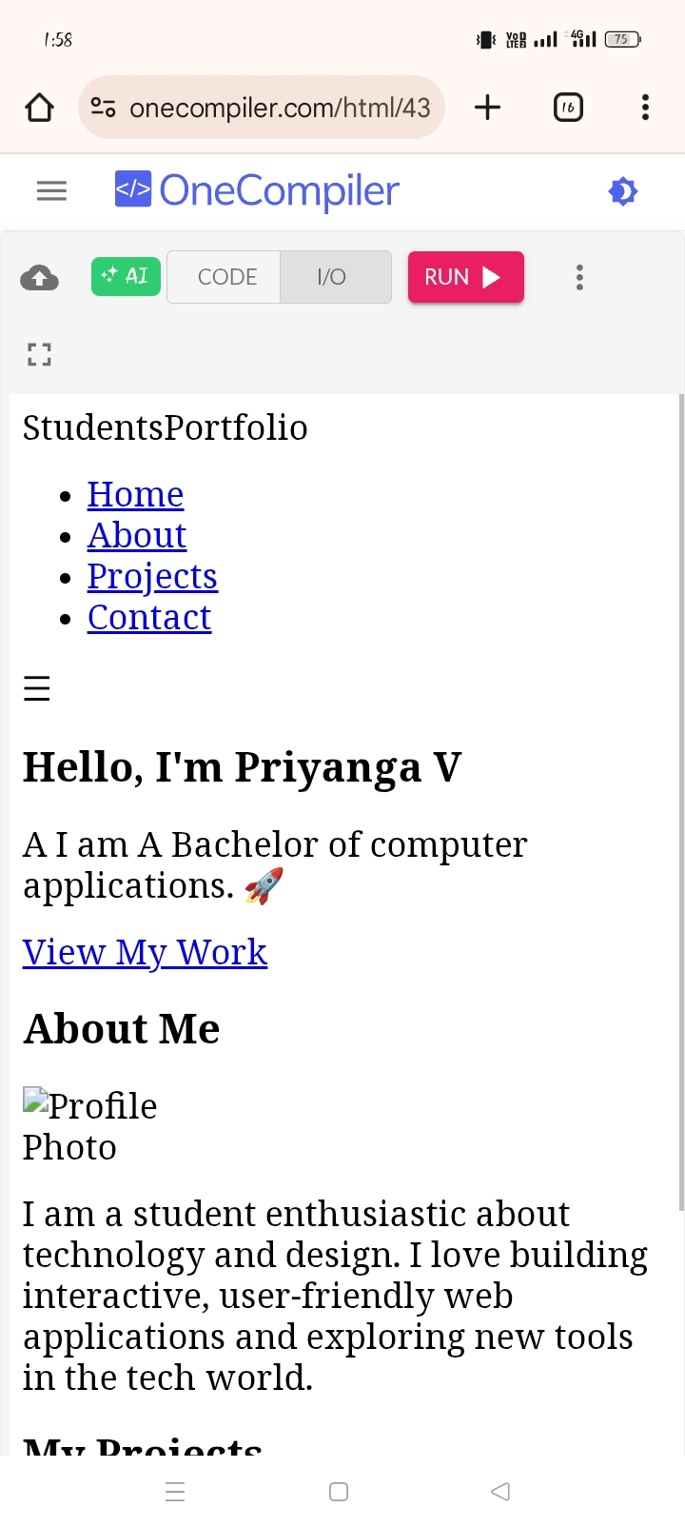

RESULTS AND SCREENSHOTS
3/21/2024 Annual Review
10

Slide 11
CONCLUSION The project has been a resounding success, empowering students and young leaders with the, knowledge and confidence to become innovation problem -solvers and change makers
11

